Slide 1
Panchayati Raj Department
Govt. of Bihar
PRD Nischay Soft Mobile App
मुख्या मंत्री ग्रामीण निश्चय योजना
This app is designed, developed, and tested by Android Team of DGRC (NIC), Patna. BIHAR.
PPT: Prepared by Android Team (NIC), Patna

Slide 2
PRD Nischay Soft Mobile App
Download
https://play.google.com/store/apps/details?id=app.bih.in.nic.nischayyojana

Slide 3
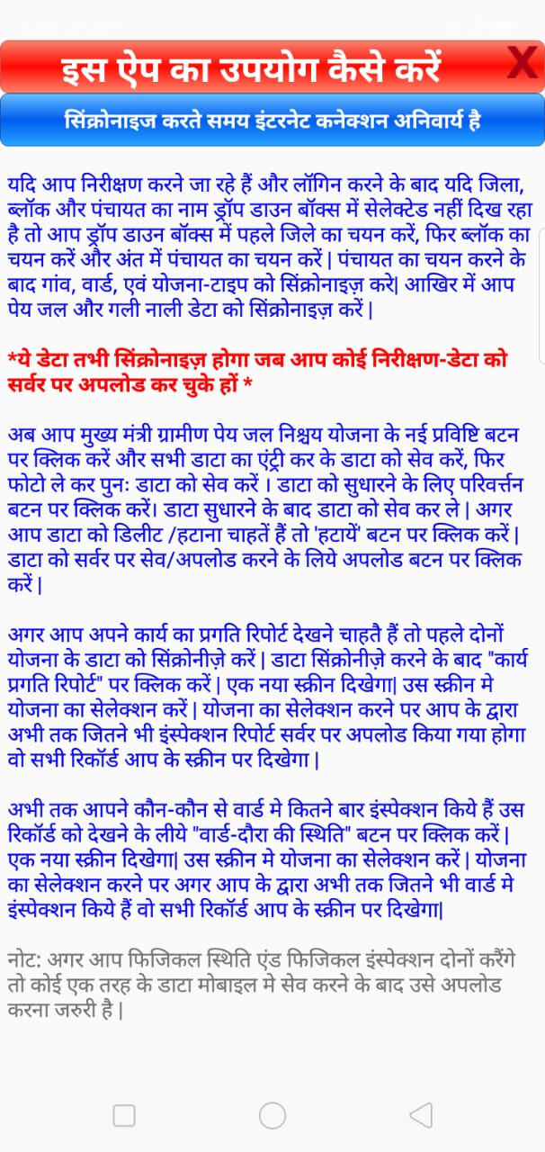
Login -> Home Screen

Slide 4
Login -> Home Screen

Slide 5
HOME SCREEN
सिंक्रनाइज़ करें : Select District , Block , Panchayat then synchronize Ward data, Yojana data, Mode of Payment data etc.
मुख्या मंत्री ग्रामीण पे जल निश्चय योजना : Panchayat level admin user can perform voucher entry and entry of Physical Progress .
मुख्या मंत्री ग्रामीण गली-नाली निश्चय योजना: Panchayat level admin user can perform voucher entry and entry of Physical Progress .
कार्य प्रगति रिपोर्ट : Panchayat level admin user can view the work progress reports.

Slide 6
Home Screen
NOTE:
After logging first of all download all the required data as shown in “सिंक्रनाइज़ करें”
green colored screen
--------सिंक्रनाइज़ करें------
*Download Ward records Panchayat wise.
* Download Yojana List Panchayat and Nischay Type wise.
* Download Mode of Payment records.
Download Financial and Physical Verification “Pay Jal Nischay Yojana” data Panchayat wise.
Download Financial and Physical Verification “Gali-Naali Pakkikaran Nischay Yojana” data Panchayat wise.

Slide 7
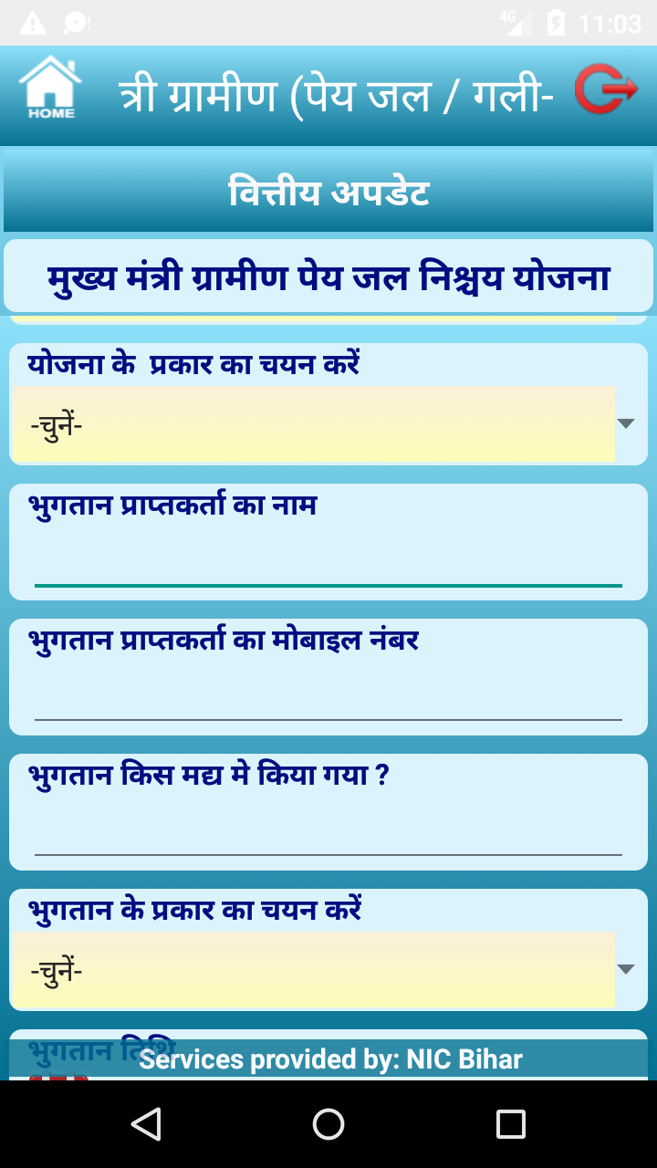
Home Screen -> Voucher Entry of Pay Jal Nischay Yojana

Slide 8
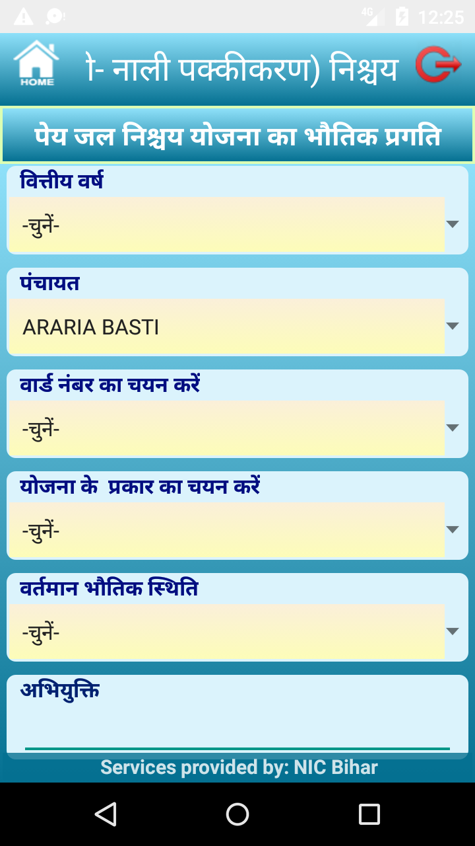
Home Screen -> Entry Physical Verification of Pay Jal Nischay Yojana

Slide 9
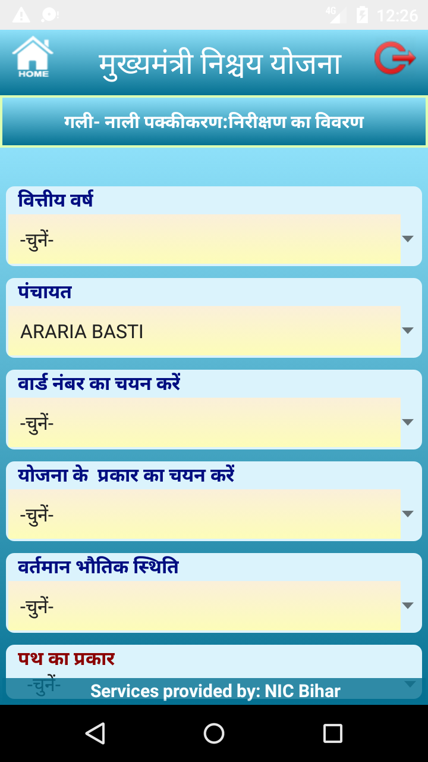
Home Screen -> Entry Physical Verification of Gali-Naali Pakkikaran Nischay Yojana

Slide 10
Home Screen -> Edit / Delete Nischay Yojana (locally)

Slide 11
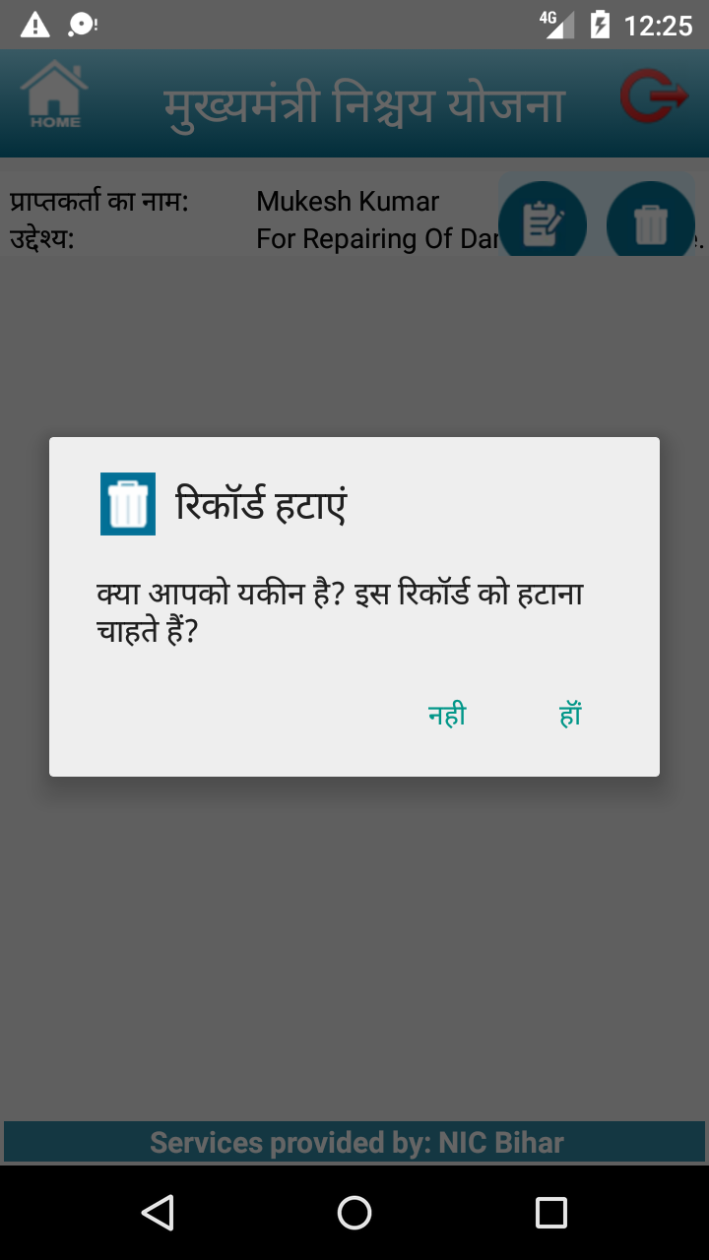
Home Screen -> Delete Nischay Yojana (locally)

Slide 12
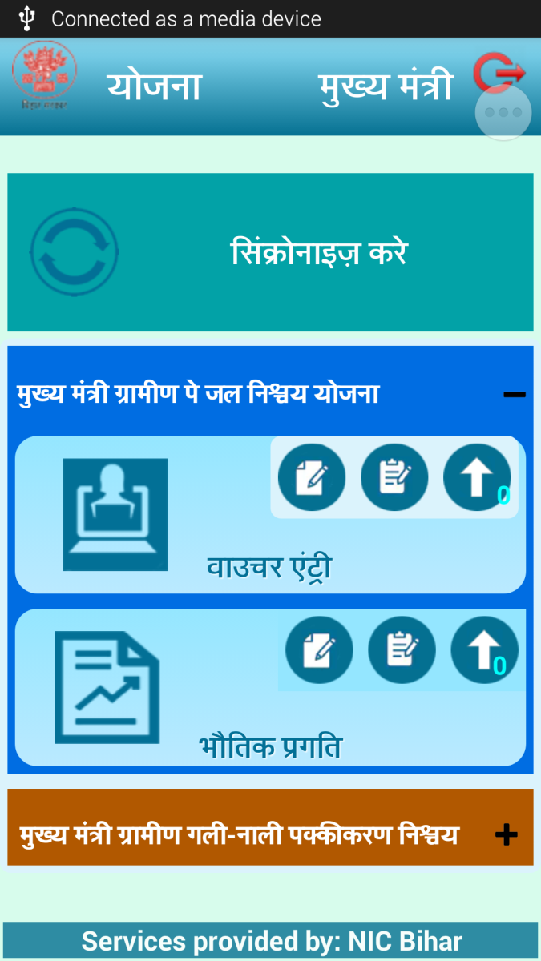
Home Screen -> Upload to Server Nischay Yojana

Slide 13
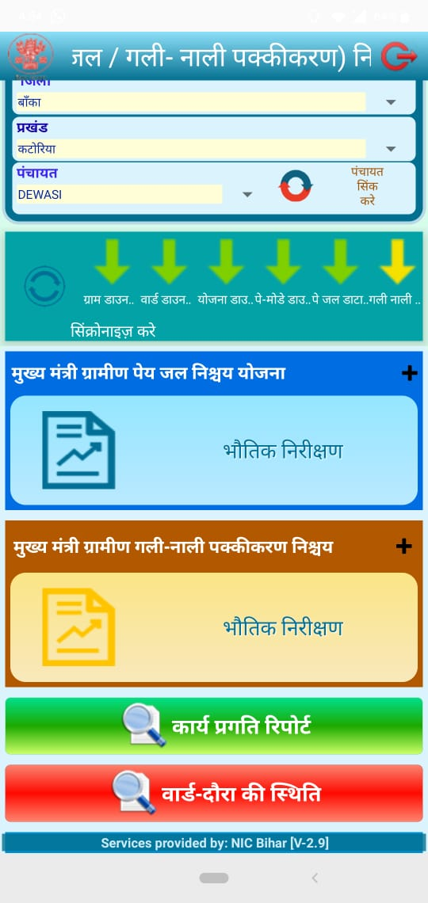
Home Screen -> Reports

Slide 14
Reports

Slide 15
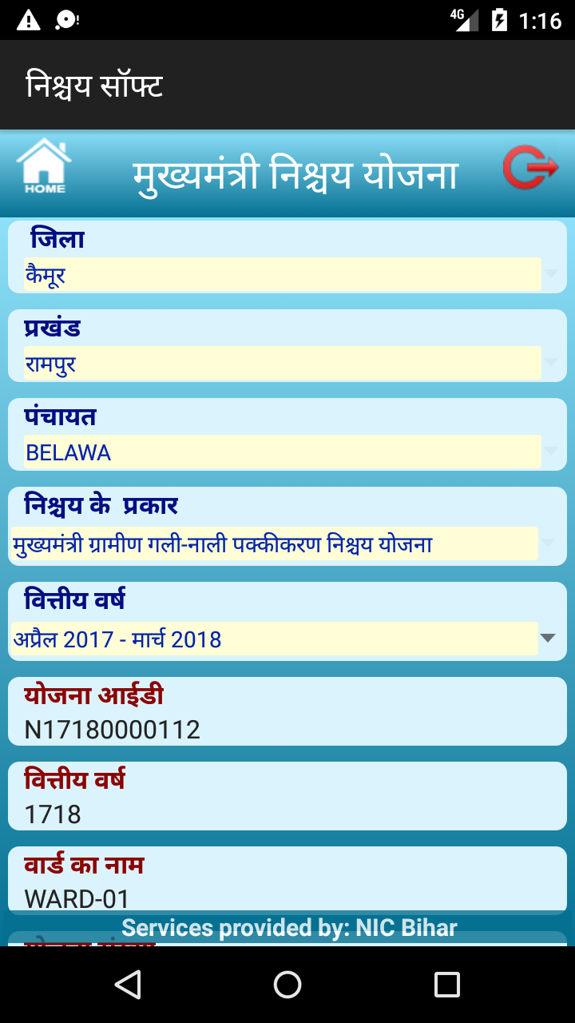
Reports

Slide 16
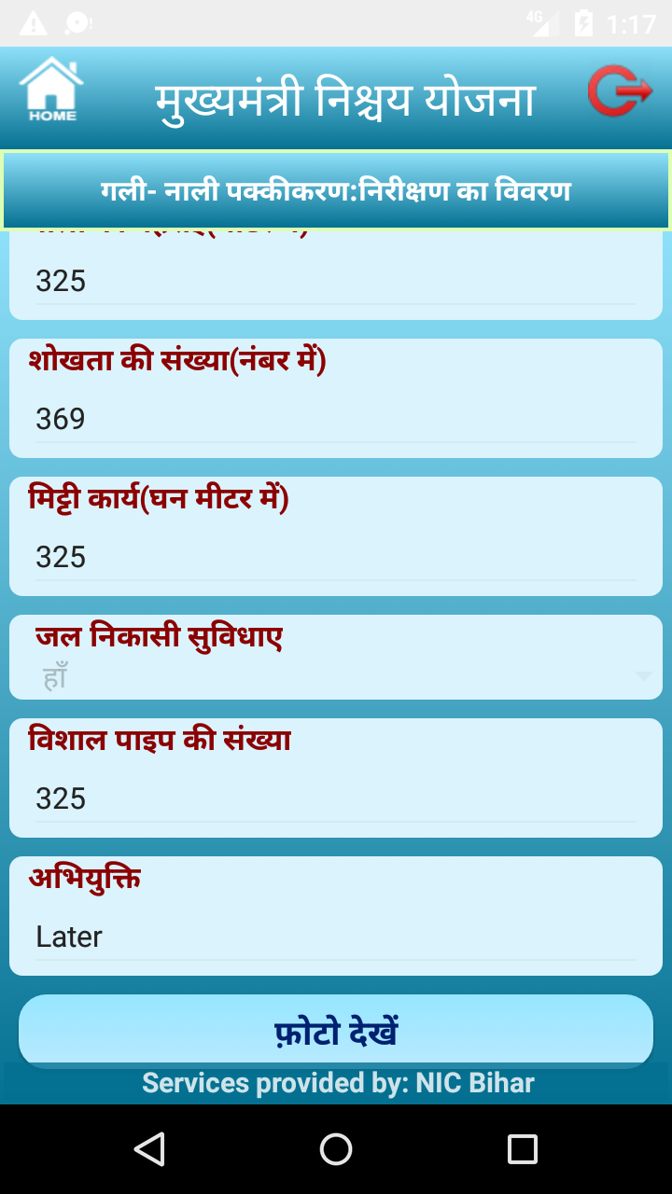
Reports

Slide 17
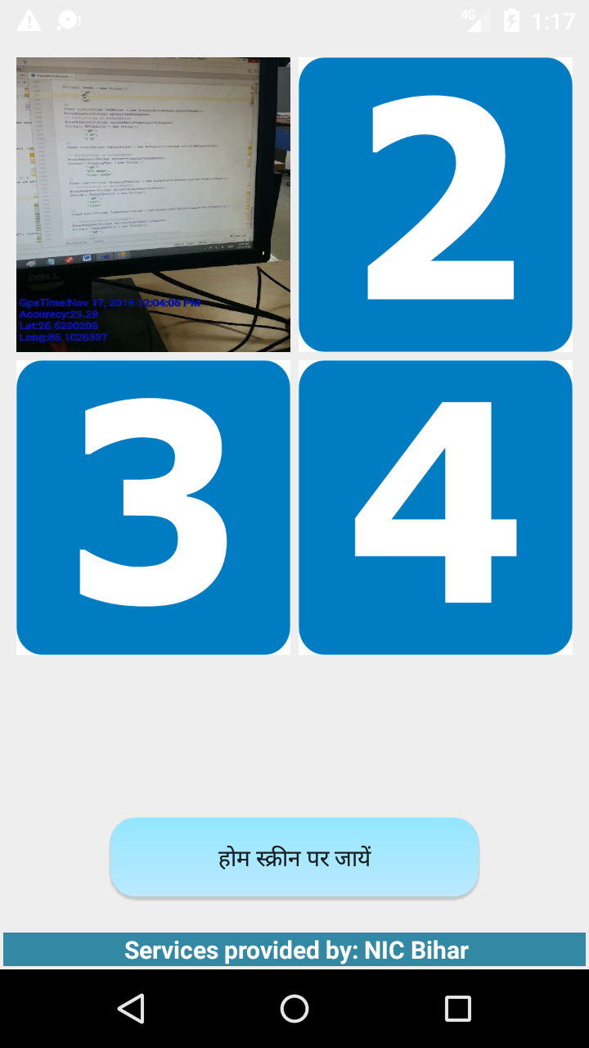
Reports

Slide 18
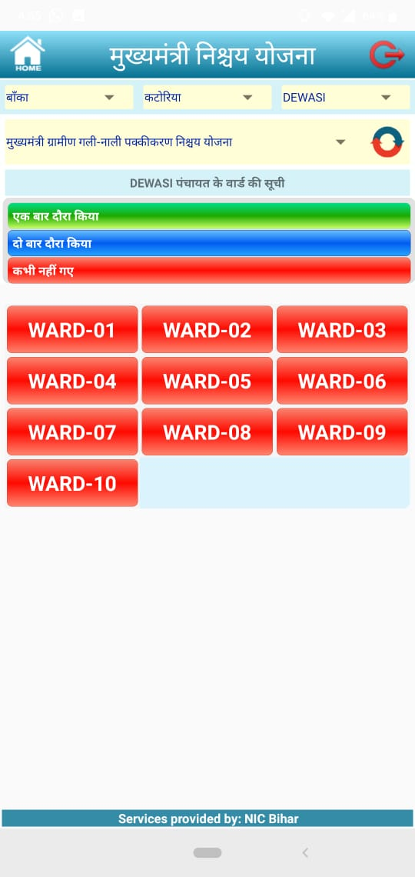
Reports

Slide 19
Thank you
DGRC (NIC), Patna, Bihar

